Slide 1

HACKATON ​CAPGEMINI​ 16/03-17/03​
Team 17 :​
GOETGHEBEUR Alexandre, ALI Muhammad, LEBRETON Gaspard, POINTEAU Adrien, TEPLOV Michael

Slide 2

How can we help hr to understand why employees are leaving and help them maintain better attractivity ?​

Slide 3

Plan
Add an LLM
Build a website
Discuss and choose the themes
Modèle training
Data clean up

Slide 4
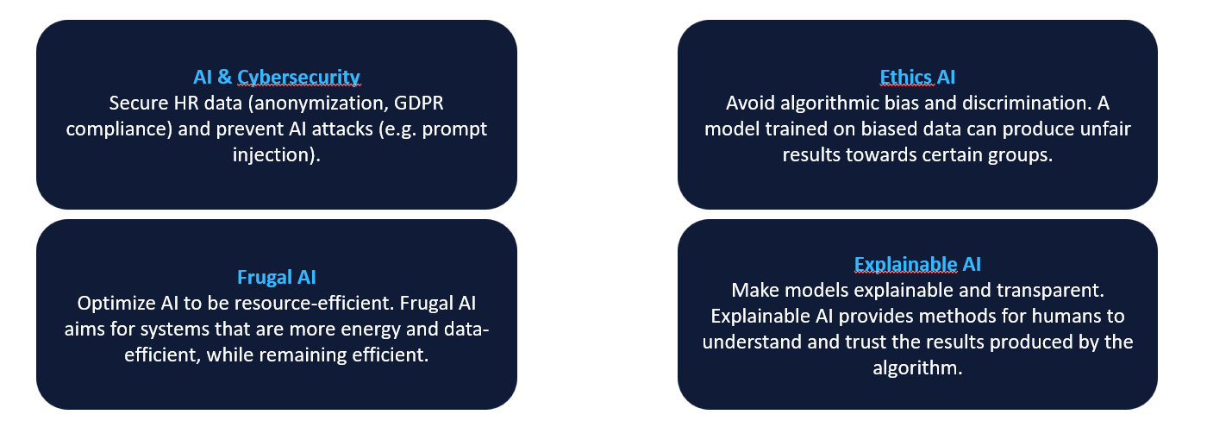
Discuss and choose the themes

Slide 5
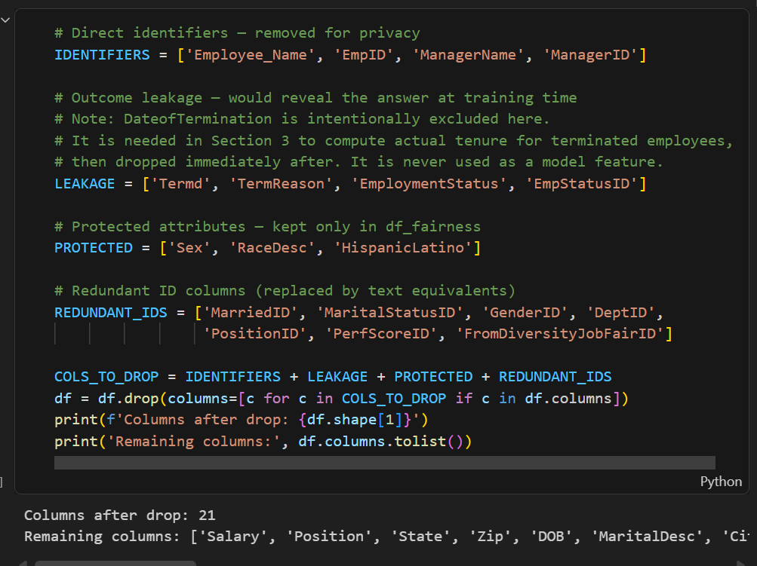
Data clean up

Slide 6
Modèle training
Logistic Regression acc : 0.7385 f1: 0.5161
Random Forest acc : 0.8279 f1: 0.5714
XGBoost acc : 0.7859 f1: 0.5517

Slide 7

Add a LLM
Gemma 3:4B localy

Slide 8
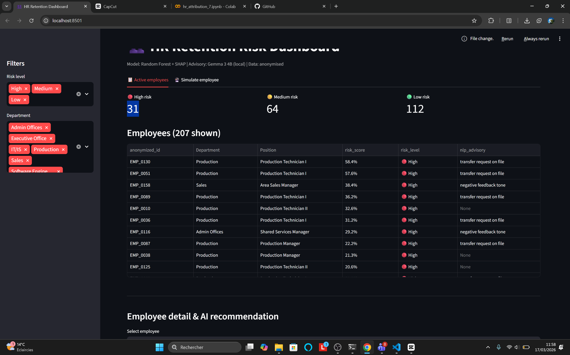
make a website

Slide 10

Merci
someone@example.com

